Slide 1
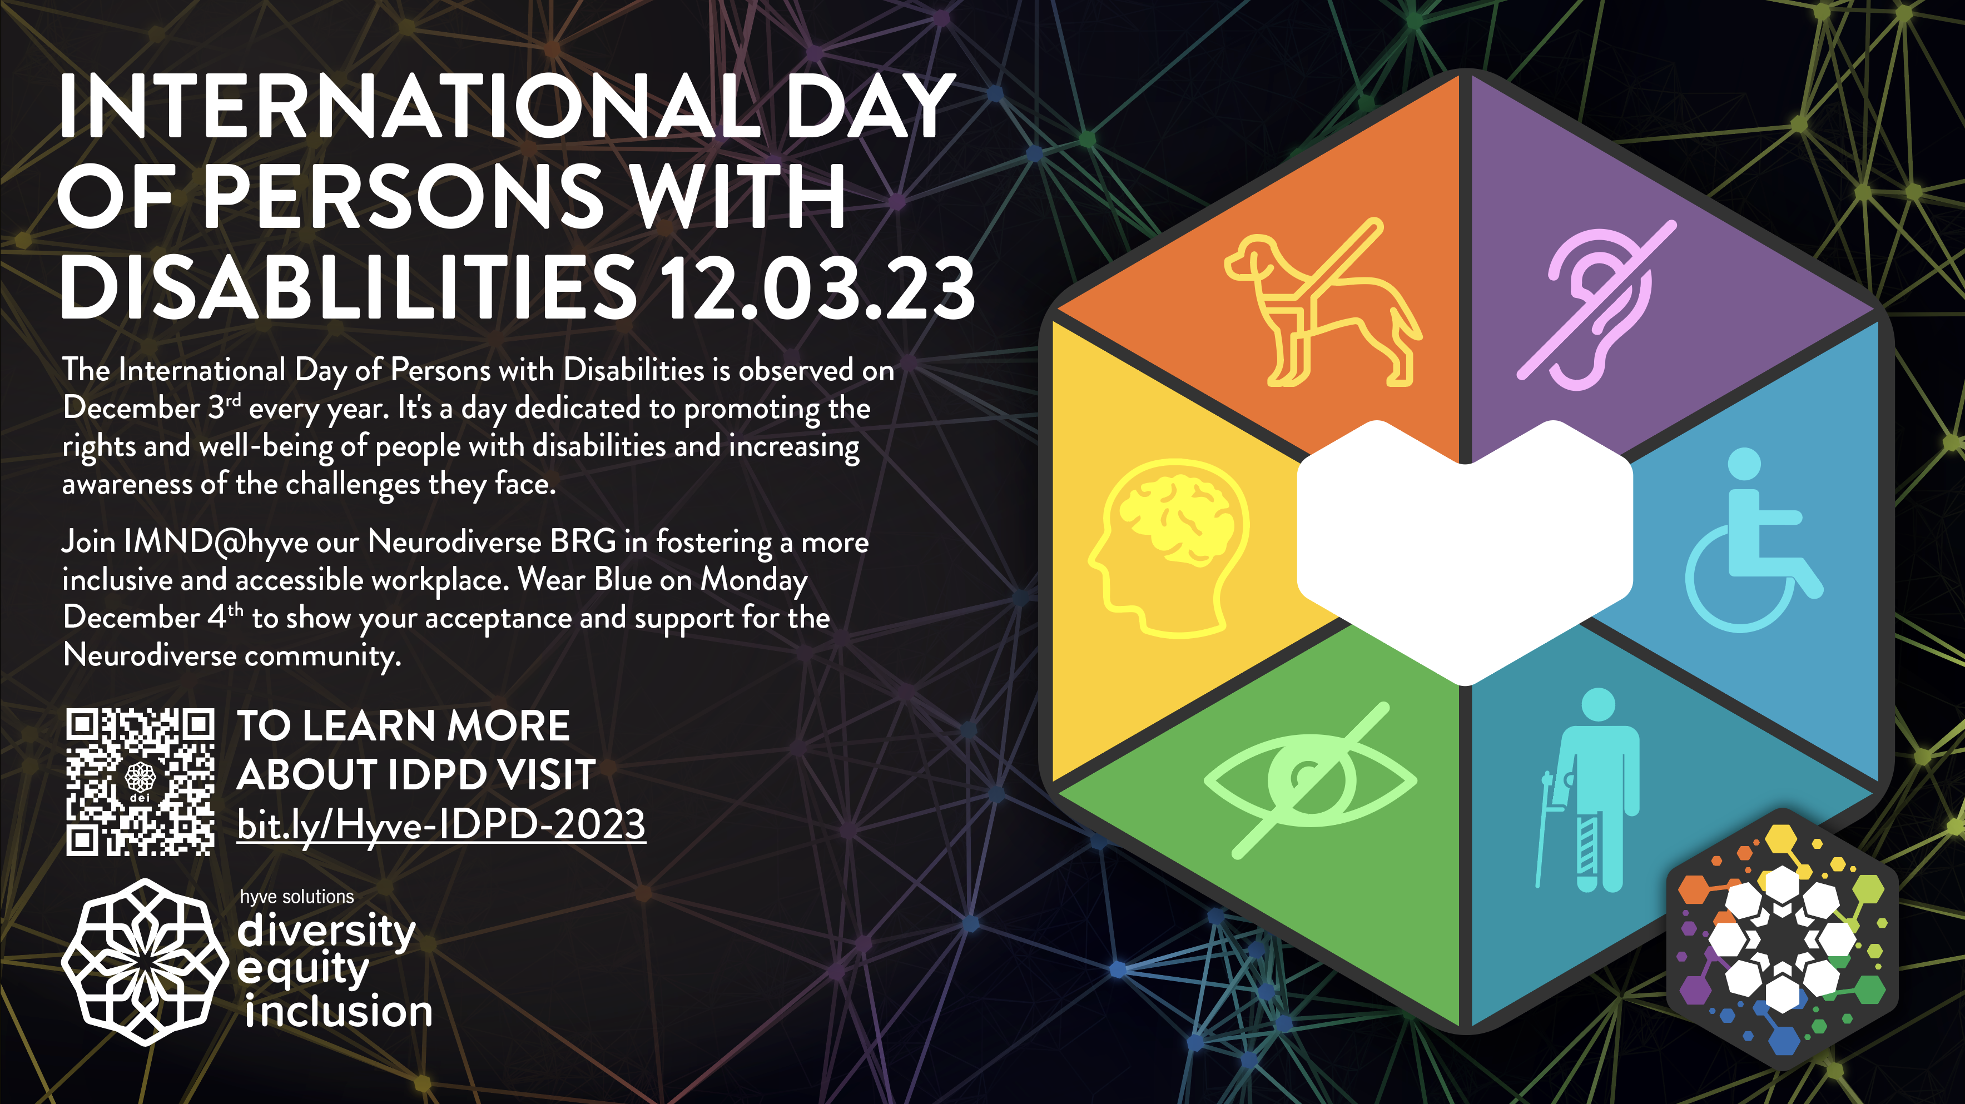

Slide 2
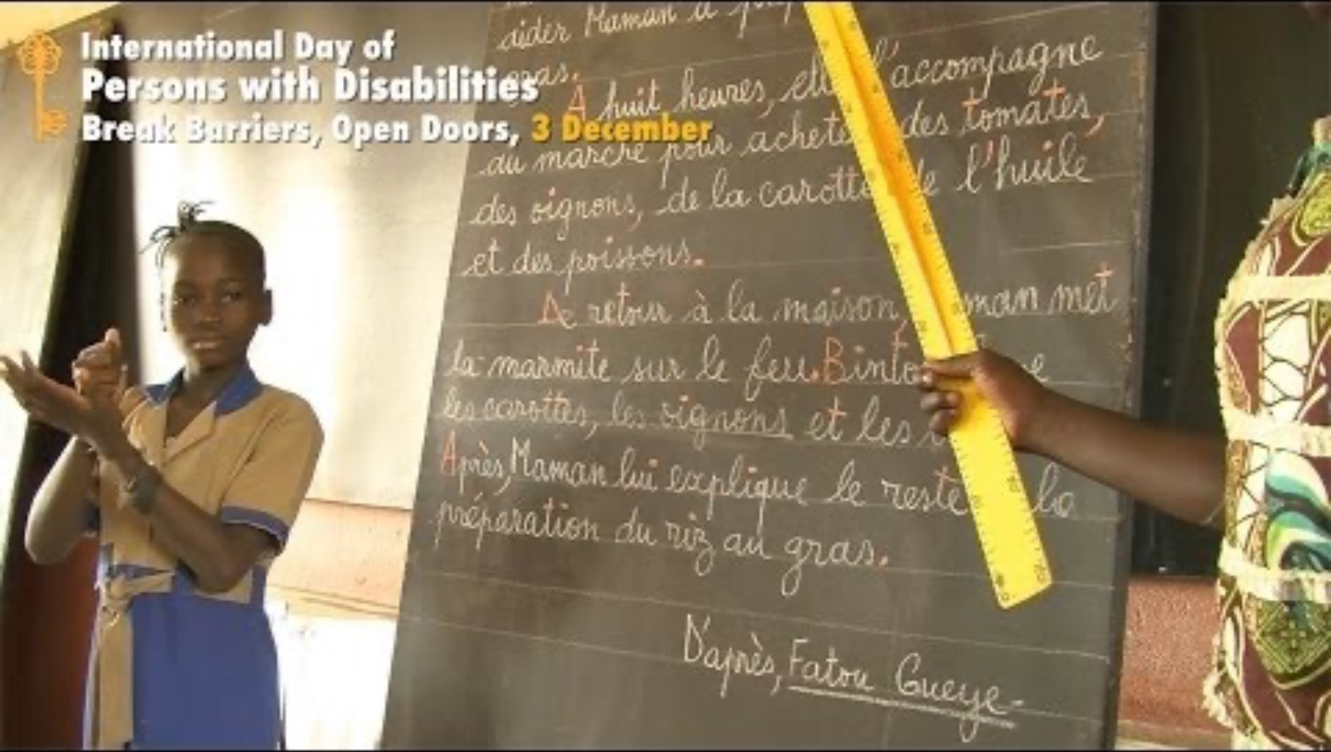

Slide 3
What is IDPD
International Day of Persons with Disabilities (IDPD) is a United Nations-sanctioned day observed annually on December 3rd to raise global awareness about the rights, challenges, and contributions of persons with disabilities.
IDPD aims to promote inclusion, accessibility, and equal opportunities for individuals with disabilities, fostering a more understanding and inclusive society.
The day encourages advocacy efforts to address barriers and promote a world where everyone, regardless of ability, can participate fully in all aspects of life.

Slide 4
The Importance of IDPD
Promoting Inclusivity: Raising awareness about the rights, experiences, and contributions of individuals with disabilities.
Challenging Stigma and Stereotypes: Challenging and breaking down stereotypes and stigmas. Allows a brave space for sharing personal stories, experiences and achievements.
Advocating for Equal Opportunity: By highlighting the barriers faced by people with disabilities and calling for the removal of these barriers, IDPD contributes to the ongoing efforts to create a world where everyone can participate fully and enjoy equal opportunities and rights.

Slide 5
Team Members from IMND@HYVE
Share what IMND is and how important it is to advocated for those Neurodiverse Ability and People with Disabilities.

Slide 6
Allyship
Create Inclusive Spaces: Encourage and participate in activities and events that promote accessibility and inclusion for all.
Support Inclusive Policies: Advocate for and support policies that promote inclusivity and equal opportunities for individuals with disabilities
Be Mindful of Language: Be mindful of the language you use and promote person-first language that emphasizes the individual rather than their disability.
Celebrate Achievement: Celebrate the achievements and contributions of individuals with disabilities. Acknowledge their successes and talents, contributing to a positive and empowering narrative.

Slide 7
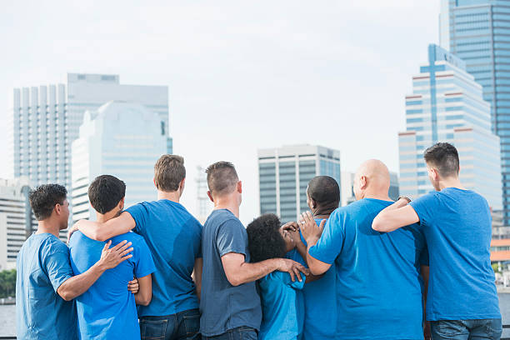
Support IMND@HYVE
On Monday December 4th in recognition of IDPD wear blue in support of our colleagues and loved ones with neurodiverse abilities and disabilities around the world

